Slide 1
Pandemic-Triggered Transitions
Susan Letterman White, JD, MS
Massachusetts Law Office Management Assistance Program
Susan@MassLOMAP.org

Slide 2
Who am I?
Senior Practice Advisor, Mass LOMAP/Lawyers Concerned for Lawyers
Former law firm managing partner and practicing attorney
Expert in individual career and organizational strategy and performance
Chair of MBA Solo/Small Firm Law Practice Management Section Council
Member, BBA Solo and Small Firm Forum
Member, MBA COVID-19 Response Task Force
Chapter Author, Hanging Your Shingle: Starting and Operating a Solo or Small Firm Practice

Slide 3
Mass LOMAP
www.masslomap.org
www.lclma.org

Slide 4
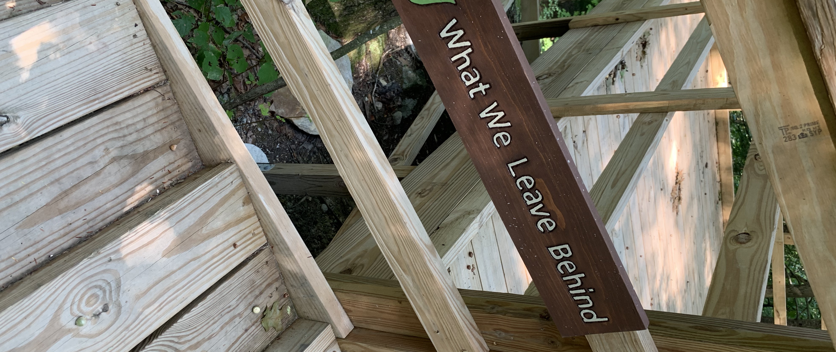
Transitions after the disruption
Endings
Neutral Zone
New Beginnings
Preparation
Let go of?
Pause and reflect
Finding and Planning for new opportunities
Source: William Bridges, Transitions
Notes:
.

Slide 5
4 Client Stories
Balance to Disruption

Slide 6
Sole owner gets sick. Single associate. Now what?

Slide 7
“Let me help.”
Good intentions. Bad Decisions.

Slide 8
"If I die now, have I lived the life I wanted to?”
“The pandemic has people examining their lives. Some don't like what they're seeing.”
Beth Teitell Globe Staff, July 5, 2020

Slide 9
Technology
Prepare or adjust?

Slide 10
ChallenGe!
What will you do now that you have been putting off?

Slide 11
Questions?
Susan@MassLOMAP.org

