Slide 1
DEVELOPING YOUR LinkedIn® ACTION PLAN
Mass LOMAP
September 2020
Allison C. Shields Johs, Legal Ease Consulting, Inc.

Slide 2
LAWYERS ON LINKEDIN
According to the ABA’s Legal Technology Survey, over 80% of lawyers have a LinkedIn presence.
But how many are using it strategically?

Slide 3
Why Should Lawyers Use LinkedIn?

Slide 4
Networking = Word of Mouth Referrals

Slide 5
LinkedIn = Networking²
Extensive network
Customizable
Updated FOR you
It’s about building relationships

Slide 6
What you do online corresponds to what you do “in real life”

Slide 7
Developing your plan
Be consistent
Make it a habit
Weekly investment:
30-90 minutes

Slide 8
Setting Goals for LinkedIn Use

Slide 9
ThREE Building Blocks of LinkedIn
PROFILES, CONNECTIONS, & PARTICIPATION

Slide 10
PROFILES
BUILDING BLOCK #1

Slide 11
Your Profile helps you to stand out from the crowd

Slide 12
WHO IS YOUR AUDIENCE?
Your LinkedIn Profile is about you, but it isn’t for you.
Just like in “real life” networking, you must be mindful of your audience and their needs.

Slide 13
Profile – start here
Upgrade your Headline
Create a well-crafted summary
Add relevant Skills
Add any necessary disclaimers

Slide 14
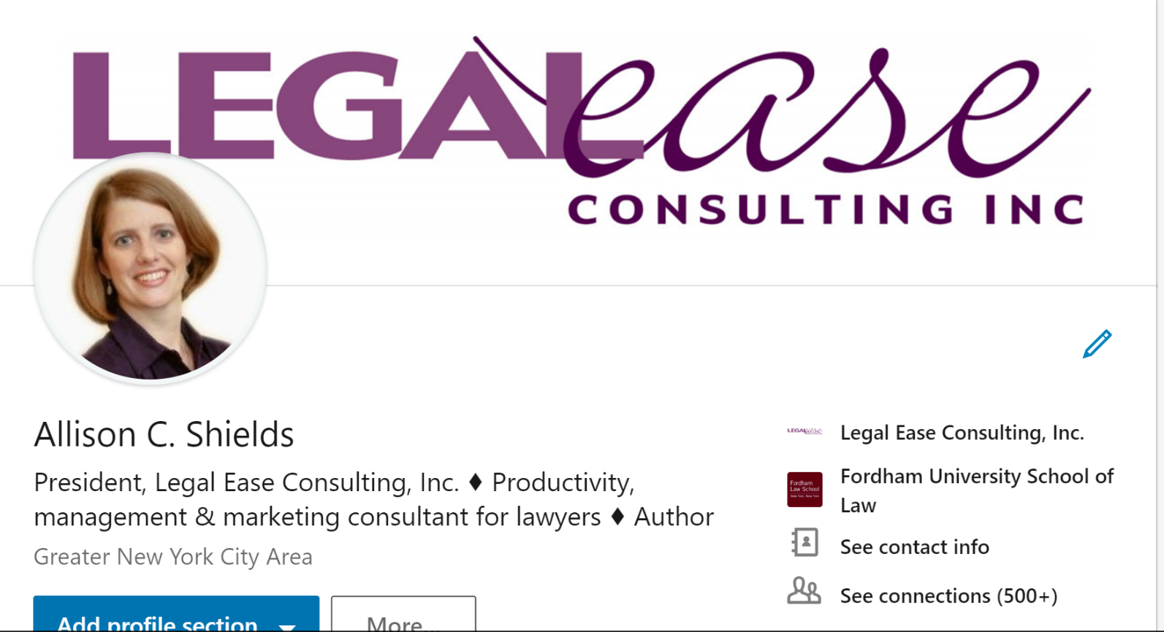
Your Professional Headline

Slide 15
Professional Headline
Consider it your mini elevator pitch
120 character limit
Be descriptive!

Slide 16
Professional Headline
Who are your clients?
What do you do for them?
What benefits do clients derive from working with you?

Slide 17
About and Experience: Details
Summary=Short Bio; “Cover letter”
Experience – Include Detail
First person
Use Keywords
Words someone would use to find you
Language potential clients use to describe skills and experience they seek
Identify your clients and their issues
Photo by Tanja Heffner on Unsplash

Slide 18
About & Experience
Write for your audience
No legalese
Stories, not legal briefs
Who, what, when, where, how, why
Notes:
Allison

Slide 19
Profile – NEXT STEPS
Add your activities to your Profile (Experience, Memberships, Honors and Awards)
Give and request recommendations and endorsements
Add media to your Profile

Slide 20
Add sections to your profile

Slide 21
LinkedIn recommendations

Slide 22
Media: About and Experience

Slide 23
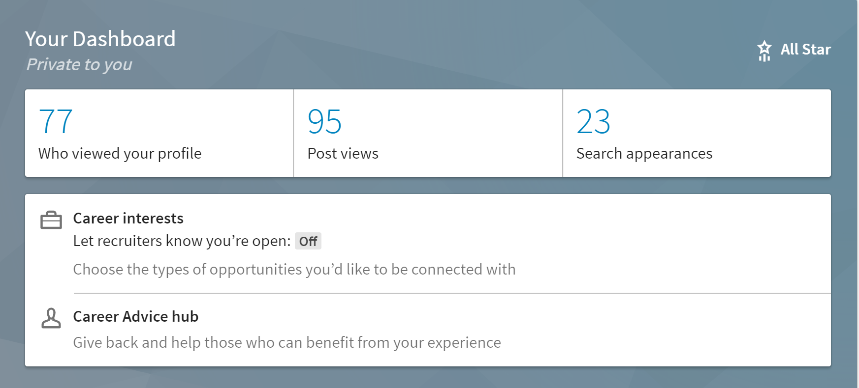
Dashboard: How Are You Doing?

Slide 24
Profile - MAINTENANCE
Update your Profile with any changes – new job, honors and awards, etc.
Review your Profile at least every 6 months to update

Slide 25
CONNECTIONS
BUILDING BLOCK #2

Slide 26
Make connections based on your goals

Slide 27
Connections – start here
Upload contacts
Send personalized invitations
Respond to invitations

Slide 28
Connecting with People
Personalize your invitations to connect
Don’t use the default invitation
Give them a reason to connect

Slide 29
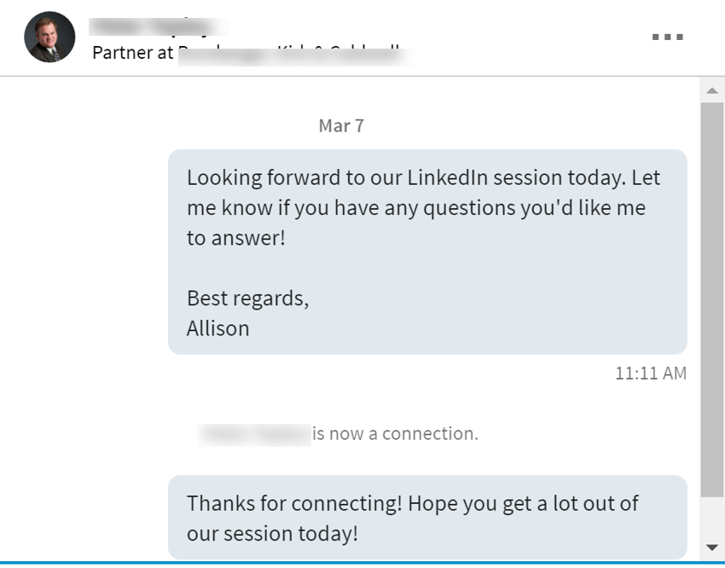
Connecting with People
Continue the conversation: thank the person for connecting

Slide 30
Connections – NEXT STEPS
Look for new people to connect with:
Groups
People You May Know
Alumni

Slide 31
People you may know

Slide 32
Alumni Search

Slide 33
Alumni Search

Slide 34
Connections - maintenance
Invite new contacts to connect
Send personalized notes
Stay in contact – follow up!

Slide 35
PARTICIPATION
BUILDING BLOCK #3

Slide 36
Reach your goals through participation

Slide 37
Participation – start here
Post to your feed at least weekly
View your feed to engage with others’ posts
Find Groups to join (start w/3)

Slide 38
Posting on LinkedIn

Slide 39
Post Tips
Information and links of interest to your audience
Articles – by you or others
Demonstrate knowledge
Become a trusted information source
80% informational; 20% “promotional”

Slide 40
Boost Engagement
Promote discussion:
Ask questions
Create polls
Include a call to action
Engage with a wider audience: add hashtags (#) to your post
Tag or @mention connections in your post

Slide 41
LinkedIn Groups
Area of practice
Personal interests
Alumni
Charitable
Other

Slide 42
Groups:
Get known outside of your circle
Establish yourself as an expert
Demonstrate knowledge
Build relationships
Develop rapport

Slide 43
What to do with Groups
Start a discussion
Like or comment on someone’s post
Search the members list for potential connections
Share a link to an article
Promote upcoming events
Post photos of past events

Slide 44
Participation – NEXT STEPS
Consider writing articles (Publisher posts)
Join or comment on Group discussions
Engage with posts on Company Pages

Slide 45
Writing an article

Slide 46
Inside LinkedIn’s Publishing Platform

Slide 47
Participation - maintenance
Post at least one Update/week
Review Group discussions and join in
Review your Home page for content ideas to share
React to others’ Updates
Take it OFFLINE!

Slide 48
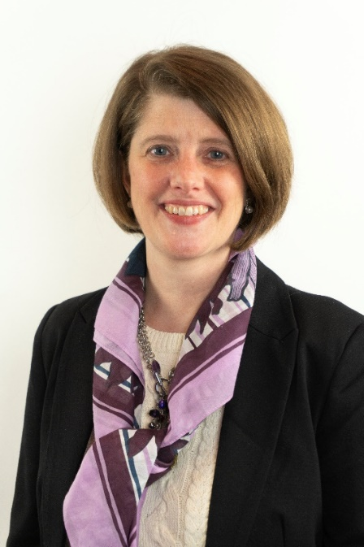
Presenter
Allison C. Shields Johs
Allison@LegalEaseConsulting.com Phone: 631-642-0221
LawyerMeltdown.com
LegalEaseConsulting.com (blog)
www.linkedin.com/in/allisoncshieldslegalease
@allisonshields

Slide 49
MAKE LINKEDIN WORK FOR YOU available on amazon.com
Paperback:
amzn.to/MLIwk4uP
Kindle:
amzn.to/MLIwk4uK

Slide 50
Questions?

